Slide 1
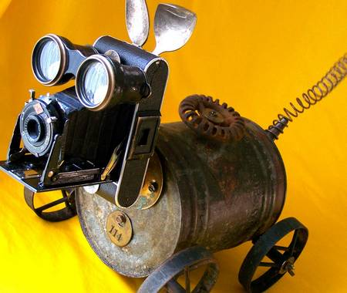
Dialogue-AMR: Abstract Meaning Representation for Dialogue
Claire Bonial¹, Lucia Donatelli², Mitchell Abrams, Stephanie M. Lukin¹,
Stephen Tratz¹, Matthew Marge^{1,} Ron Artstein³, David Traum³, & Clare R. Voss¹
¹ U.S. Army Research Laboratory, ²Saarland University, ³Institute for Creative Technologies
Language Resources and Evaluation (LREC) 2020
Notes:
Find a different photo
Change footer
Ron: what do people want to know at workshop? Why do it this way rather than a dialogue structure scheme?
“Incrementally taming natural language”, rather than restricting it
Clare: we are constrained in getting this to be executable
Work backwards: Language that robot can execute is very specific; yet we find variety is paramount

Slide 2
Roadmap
Introduction: Human Robot Dialogue
Background
SCOUT Corpus
Abstract Meaning Representation
Dial-AMR
Speech Acts
Tense and Aspect
Evaluation
Conclusion and Discussion
Please ask questions throughout if something is unclear or you would like to know more!

Slide 3
Questions to begin (in groups?)
How is human-robot dialogue different from human-human dialogue?
How is task-based dialogue different from more open-ended dialogue?

Slide 4
Some initial thoughts
Humans and robots do not have the same environmental awareness, especially when in different locations
How do we establish and model common ground?
How does a robot’s “language” reflect its “knowledge”?
Humans talk differently to robots
How do we elicit representative data?
What is our goal for the robot’s communicative abilities?
By nature, utterances in a task-oriented dialogue can always relate to the goal at hand
How do we specify task-specific interpretations while allowing for generalization to new scenarios?

Slide 5
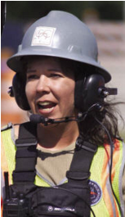
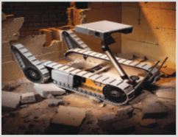
Introduction
Broad goal: system for dialogue between a person and remotely located robot (unknown environment)
Robot, rotate 180 degrees
Instructions: very distinct language
Robot, turn around back the way you came
Execution: same action
Notes:
In the language of this domain, we find that people
communicating with robots often employ multiple
ways of saying the same thing; for example… (an alternate example, even harder, is something like: do you remember where you started?)

Slide 6
Introduction
Broad goal: system for dialogue between a person and remotely located robot (unknown environment)
Can you take a picture?
Execution: take picture
Instructions: very similar language
Can you speak Arabic?
Execution: respond to information request
Notes:
However, they also
employ very similar syntactic structures to say different
things: Can you take a picture?, intended as
a polite request for a picture, and Can you speak
Arabic?, intended as a question of the robot’s abilities.
Add: in an unknown environment

Slide 7
Introduction
Broad goal: system for dialogue between a person and remotely located robot (unknown environment)
Can you take a picture?
Execution: take picture
(p / picture-01
:mode imperative
:polite +
:ARG0 (y2 / you)))
Can you read Arabic?
(p / possible-01 :ARG1 (r / read-01 :ARG0 (y / you) :ARG3 (l / language :name (n / name :op1 "Arabic"))) :polarity (a / amr-unknown))
Execution: respond to information request
Notes:
To get at the underlying meaning of these utterances
despite surface variations and similarities,
our goal is to develop semantic representations for
this project. We plan to use these representations
in an implemented, live system to facilitate both
NLU of the robot-directed instructions as well as
Natural Language Generation (NLG) of robot responses
and feedback.
*maybe take this slide out and put overview slide here.

Slide 8
Background: Human-Robot Dialogue Corpus
We collected/are collecting a corpus of observed data from the target domain via a phased Wizard-of- Oz approach (Marge et al., 2016, 2017)
82 participants over four separate phases
~20 hours interaction annotated with multi-floor dialogue structure scheme (60 dialogues up to 20 minutes each) (Traum et al., 2018) Note: these are dialogue moves/acts, as opposed to speech acts
Lacks information about the CONTENT of the utterance:
What is the action instructed? What are the parameters of that action?
Notes:
In this type of evaluation, a human “wizard” takes on the role of the robot so that we can mimic ideal behavior and see how a human interacts naturally. Over four phases, our goal is to reduce the human intermediaries.
Annotation serves to identify what humans say, how humans use the language we do, and what dialogue relations exist in this type of exchange. This extralinguistic information is useful for a potentially automated system in the future.
Talk through movement of multi-floor dialogue and possibly add arrows to make clearer
Add photos: to indicate participants

Slide 9
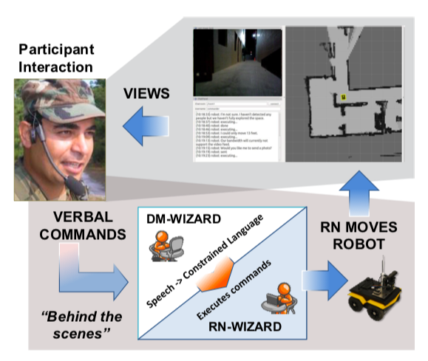
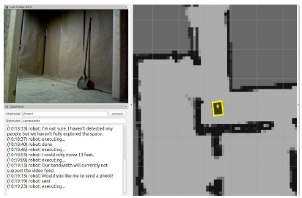
Background: Human-Robot Dialogue Corpus
Participant (commander) view
Wizard-of-Oz data collection setup

Slide 10
Some Observations about the Data
Humans speak to robots in very simple language
Majority commands
Few hypothetical situations
Low-level actions (hopefully more complex in the future..)
Often multiple possible interpretations for an utterance
Is Wizard-of-Oz the best method for eliciting data in this domain?

Slide 11
Background: AMR
AMR is a broad coverage sentence-level semantic representation framework that abstracts away from surface variation.
Notes:
As stated before, our goal is to develop semantic representations for the sentences in the dialogue, to put linguisitc content to its illocutionary force or pragmatic effect. This distinguishes „sentence meaning“ from „utterance meaning“.
We choose AMR for many reasons, but primarily due to the existence of semantic parsers and annotated data, as well as the framework that allows us to abstract away from syntactic structure.
“Incrementally taming natural language”, rather than restricting it
We want a domain-specific representation that is directly translatable to robot action

Slide 12
Evaluating Suitability of AMR
Goal: Human communicates with remotely located robot to explore spaces and identify scenes and objects
AMR (current version): Does not capture vital linguistic cues for fluid dialogue in this domain
1. “I will move forward.”
2. “moving…”
3. “I moved forward.”
Parser output of “Move forward”
(m / move
:ARG1 (i / i)
:direction (f / forward))
Notes:
To remind you of our goal, we‘d like to have fluid communication between a human and a remotely located robot to explore spaces and identify scenes and objects. Currently, AMR lacks vital information to do this. For example, these three utterances are all currently represented the same in AMR.
To amend AMR for our purposes, I will now talk about three updates we‘ve made to it for our task: (i) adding tense and aspect information; (ii) adding speech act information; and (iii) adding information relevant to spatial parameters.
this is a bit tricky because we want it to be clear that, under current guidelines, even gold standard AMRs for will move forward/moving/moved would all be the same. I.e. this isn't just a parser problem requiring more data, but also, because there is so little imperative training data, parser output is largely appearing the same, with the exception that we really aren't getting null subjects at all.
There isn't even really consistency as to how "forward" is treated either, but I don't think we want to get into that here.

Slide 13
List of Refinements for Dial-AMR
Speech Acts
Distinguish linguistic content and speaker intention
Represent dialogue participant roles
Tense and aspect
Clarify when and how events in dialogue occur
Spatial parameters
Necessary for grounding and execution of robot activities
Specification of here, there, etc.
Notes:
Distinguish content of sentence from speaker intention behind utterance
I will discuss these in order

Slide 14
Refinements: Speech Acts
Adding speech acts allows us to encode the implied intention behind human utterances
“Robot, move forward 2 feet.”
“Can you move forward 2 feet?”
6 speech act types​
command​
assert​
request​
question ​
evaluate​
express
Each type has 5-12 subtypes, e.g.:​
​command:send-image​
command:move​
command:turn​
command:repeat​
command:cancel
36 Unique “Bot Language“ Dialogue AMRs
Notes:
Allow robot to decode implied intention behind human input. Similar to dialogue structure annotation mentioned earlier: goal is pair linguistic content (sentence meaning) with pragmatic effect (utterance meaning).
animation
Currently these are specific to our domain and provide coverage of the utterances in our corpus, though this set can be generalizaed and expanded given our design (as you will see on the next slide)

Slide 15
Refinements: Speech Acts
“Robot, move forward.”
PREVIOUS
UPDATED
(m / move
:ARG1 (r / robot)
:direction (f / forward))
(c / command-02
:ARG0 (cmd / commander)
:ARG1 (r / robot)
:ARG2 (g / go-02
:ARG1 r
:direction (f / forward)))
1. Embedded structure for speech act and content
2. Existing word senses for speech act and content (blue)
3. Participant roles (green)
Notes:
A full structure of a speech act type is seen here. Three components are particularly useful in this representation…
animation

Slide 16
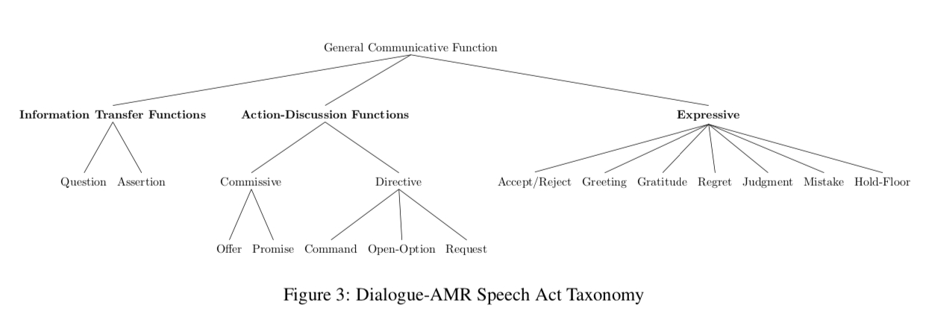
Refinements: Speech Acts
Speech Act Argument Structure:
Arg0: Speaker
Arg1: Content
Arg2: Addressee

Slide 17
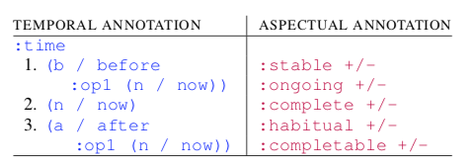
Refinements: Tense & Aspect
Adding tense and aspect allows us to distinguish events on a timeline
Annotation scheme from Donatelli et al. (2018)
1. “Robot, move forward 2 feet.”
2. “moving (forward 2 feet)…”
3. “I moved forward (2 feet).”
:ongoing -
:complete +
:time (b /before
:op1 (n / now)
:completable +
:time (a / after
:op1 (n / now)
:ongoing +
:complete -
:time (n / now)
Notes:
This tense/aspect annotation scheme is developed from the Donatelli et al. (2018) scheme. With this annotation we can distinguish events on a timeline, which is helpful for both human and robot to identify real actions, whether or not they are complete.

Slide 18
Refinements: Tense & Aspect
Essential for our domain:
Is a given action executable for the robot?
“Robot, move forward.”
CANNOT EXECUTE
“Robot, move forward 2 feet.”
“Robot, move to the doorway.”
CAN EXECUTE
“Robot, move forward 2 feet.”
“Robot, move to the doorway.”
“Robot, move forward.”
:completable -
:time (a / after
:op1 (n / now))
:completable +
:time (a / after
:op1 (n / now))
Notes:
In regards to tense and aspect, our robot is currently very goal oriented, in the sense that actions that are exectable need clear start and endpoints. The first command is not currently executable, especially given the time lag in communication. The second two are executable. We encode this in AMR by adding an aspectual category that denotes a goal, :completable + or -. We can also mark the time of an event relative to the speech time, leveraging current AMR annotation for :time relations.
:completable +/- as an aspectual distinction, not unique to this domain and robot actions
Can we identify whether or not something is executable for robot given its aspect?
Cannot execute – we don‘t want this to occur,

Slide 19
Refinements: Spatial Information
command:move
“Move forward”
(c / command-02
:ARG0-commander
:ARG1-listener
:ARG2 (g / go-02
:ARG1-mover
:ARG2-distance
:ARG3-start point
:ARG4-end point
:path
:direction))
(c / command-02
:ARG0 (cmd / commander)
:ARG1 (r / robot)
:ARG2 (g / go-02
:ARG1 r
:ARG2 (u / unspecified)
:ARG3 (h / here)))
triggers clarification question
“How far forward?”
Notes:
This is directly related to the tense/aspect annotation described earlier. Spatial parameters set in the templates both specify whether or not actions are executable and allow robots to learn BotL-specific actions. Future NLG work can Foster parallel templates in the form of robot requests for clarification and assertions.
This allows us to specify which arguments are necessary for robot operationalization.

Slide 20
Dial-AMR Templates
1
“Move forward”
(c / command-02
:ARG0 (cmd / commander)
:ARG1 (r / robot)
:ARG2 (g / go-02 :completable +
:ARG1 r
:ARG2 (u / unspecified)
:ARG3 (h / here)
:direction (f / forward)
:time (a / after
:op1 (n / now)))
2
“How far forward?”
(r / request-01
:ARG0 (r / robot)
:ARG1 (cmd / commander)
:ARG2 (g / go-02 :completable +
:ARG1 r
:ARG2 (a / amr-unknown)
:ARG3 (h / here)
:direction (f / forward)
:time (a / after
:op1 (n / now)))
3
“5 feet”
(a / assert-01
:ARG0 (cmd / commander)
:ARG1 (r / robot)
:ARG2 (m / map
:op1 (d / distance-quantity :quant 5
:unit (f / foot)))
Multi-sentence AMR (O‘Gorman et al. 2018) may be used to model discourse units and relations between them
Notes:
We can model a mini-dialogue that makes use of all these refinements.

Slide 21
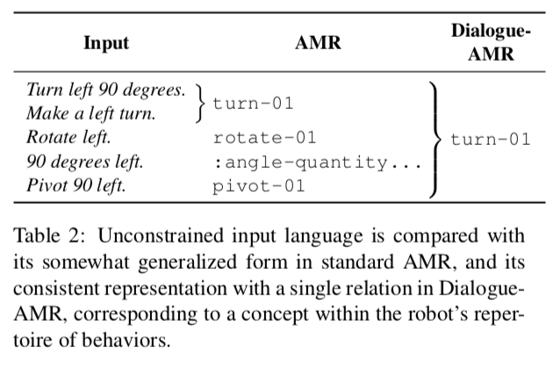
Dial-AMR Specs
Inter-annotator agreement
Parsing Results
Graph-to-graph transformations

Slide 22
Ongoing & Future Work: Implementation
1.
robot-directed
natural language
2.
abstract meaning representation
3.
domain-specific
meaning representation
4.
robot response & operationalization
Graph-to-Graph Conversion
(m / move-01 :ARG0 (y / you :direction (f / forward) …
(c / command-02 :ARG0 (cmd / commander) :ARG1 (r / robot)
:ARG2 (g / go-02)…
Dialogue Manager
(NLU)
AMR Parser
“move forward…”
(a / assert-02
:ARG0 (r / robot)
:ARG2 (cmd / commander)
:ARG1 (b / be-done-08) …
Action Specification
“done”

Slide 23
Conclusions
Dial-AMR is a robust and systematic framework updated with information regarding speaker intention (speech acts), tense/aspect, and spatial parameters.
AMR can be further updated for the task specifications, especially related to tense, aspect, negation, and modality
1. Can you move past the table? /
If you can, move past the table
2. Do that again.
3. No, turn left.
Notes:
What is the meaning of these phrases?
For our purposes, the first utterance should be an indirect speech act, yet it would be nice if our robot understood flavors of modality to be able differentiate something like „Can you take a picture?“ from „Can you speak Arabic?“ to „Could you read that for me pleae?“. We want our robot to understand the underlying presuppositions that come with these different forms, yet do so automatically in a human wayl.
For the second utterance, the assumed speaker intention is short-hand to issue the same command a second time.
However, what behavior should we expect if “do that again” is uttered after the completion of a complex command such as “go to the next doorway, turn around, and take a picture” or after only part of the command had been executed. How far back in time should the robot know to look back? Or should it be action based?
Ambiguous statements like these that are very common in robot-directed speech, and human speech in general, is built up of tacit knowledge of these categories and how they are encoded in language that non-human agents lack.
Can they figure out what is difficult about these statements?

Slide 24
Questions
Are there counterfactuals in the data?
How do robots learn new concepts?
Any surprises in the data?
Do our temporal relations provide enough coverage?
Is there a dialogue state we track?
How to calculate inter-annotator agreement?
What does ‘now’ represent temporally?

Slide 25
Thank you!
Feel free to reach out with questions/comments:
lucia.donatelli@gmail.com

Slide 26
References
Banarescu, L., Bonial, C., Cai, S., Georgescu, M., Griffitt, K., Hermjakob, U., Knight, K., Koehn, P., Palmer, M. & Schneider, N. (2013, August). Abstract meaning representation for sembanking. In Proceedings of the 7th Linguistic Annotation Workshop and Interoperability with Discourse (pp. 178-186).
Donatelli, L., Regan, M., Croft, W., & Schneider, N. (2018, August). Annotation of tense and aspect semantics for sentential AMR. In Proceedings of the Joint Workshop on Linguistic Annotation, Multiword Expressions and Constructions (LAW-MWE-CxG-2018) (pp. 96-108).
Flanigan, J., Thomson, S., Carbonell, J., Dyer, C., & Smith, N. A. (2014, June). A discriminative graph-based parser for the abstract meaning representation. In Proceedings of the 52nd Annual Meeting of the Association for Computational Linguistics (Volume 1: Long Papers) (pp. 1426-1436).
Leuski, A., & Traum, D. (2011). NPCEditor: Creating virtual human dialogue using information retrieval techniques. Ai Magazine, 32(2), 42-56.
Lukin, S. M., Gervits, F., Hayes, C. J., Leuski, A., Moolchandani, P., Rogers III, J. G., ... & Traum, D. (2018). Scoutbot: A dialogue system for collaborative navigation. In Proceedings of ACL 2018, System Demonstrations, pages 93–98, Melbourne, Australia.
Notes:
Expand citations.

Slide 27
References
Marge, M., Bonial, C., Byrne, B., Cassidy, T., Evans, A. W., Hill, S. G., & Voss, C. (2017). Applying the Wizard-of-Oz technique to multimodal human-robot dialogue. In ROMAN2016: IEEE International Symposium on Robot and Human Interactive Communication.
Marge et al. 2017. Exploring variation of natural human commands to a robot in a collaborative navigation task. In Proceedings of the First Workshop on Language Grounding for Robotics , pages 58–66.
O’Gorman et al. 2018. AMR beyond the sentence: The multi-sentence AMR corpus. In Proceedings of the 27th Inter- national Conference on Computational Linguistics, pages 3693–3702.
Traum, D., Henry, C., Lukin, S., Artstein, R., Gervits, F., Pollard, K., Bonial, C., Lei, S., Voss, C. & Hayes, C. (2018, May). Dialogue Structure Annotation for Multi-Floor Interaction. In Proceedings of the Eleventh International Conference on Language Resources and Evaluation (LREC-2018).
Traum, D. R. (1999). Speech acts for dialogue agents. In Foundations of rational agency (pp. 169-201). Springer, Dordrecht.
Traum, D. R., & Larsson, S. (2003). The information state approach to dialogue management. In Current and new directions in discourse and dialogue (pp. 325-353). Springer, Dordrecht..
Wang, C., Xue, N., & Pradhan, S. (2015). A transition-based algorithm for AMR parsing. In Proceedings of the 2015 Conference of the North American Chapter of the Association for Computational Linguistics: Human Language Technologies (pp. 366-375).
Notes:
Expand citations.

